Slide 1
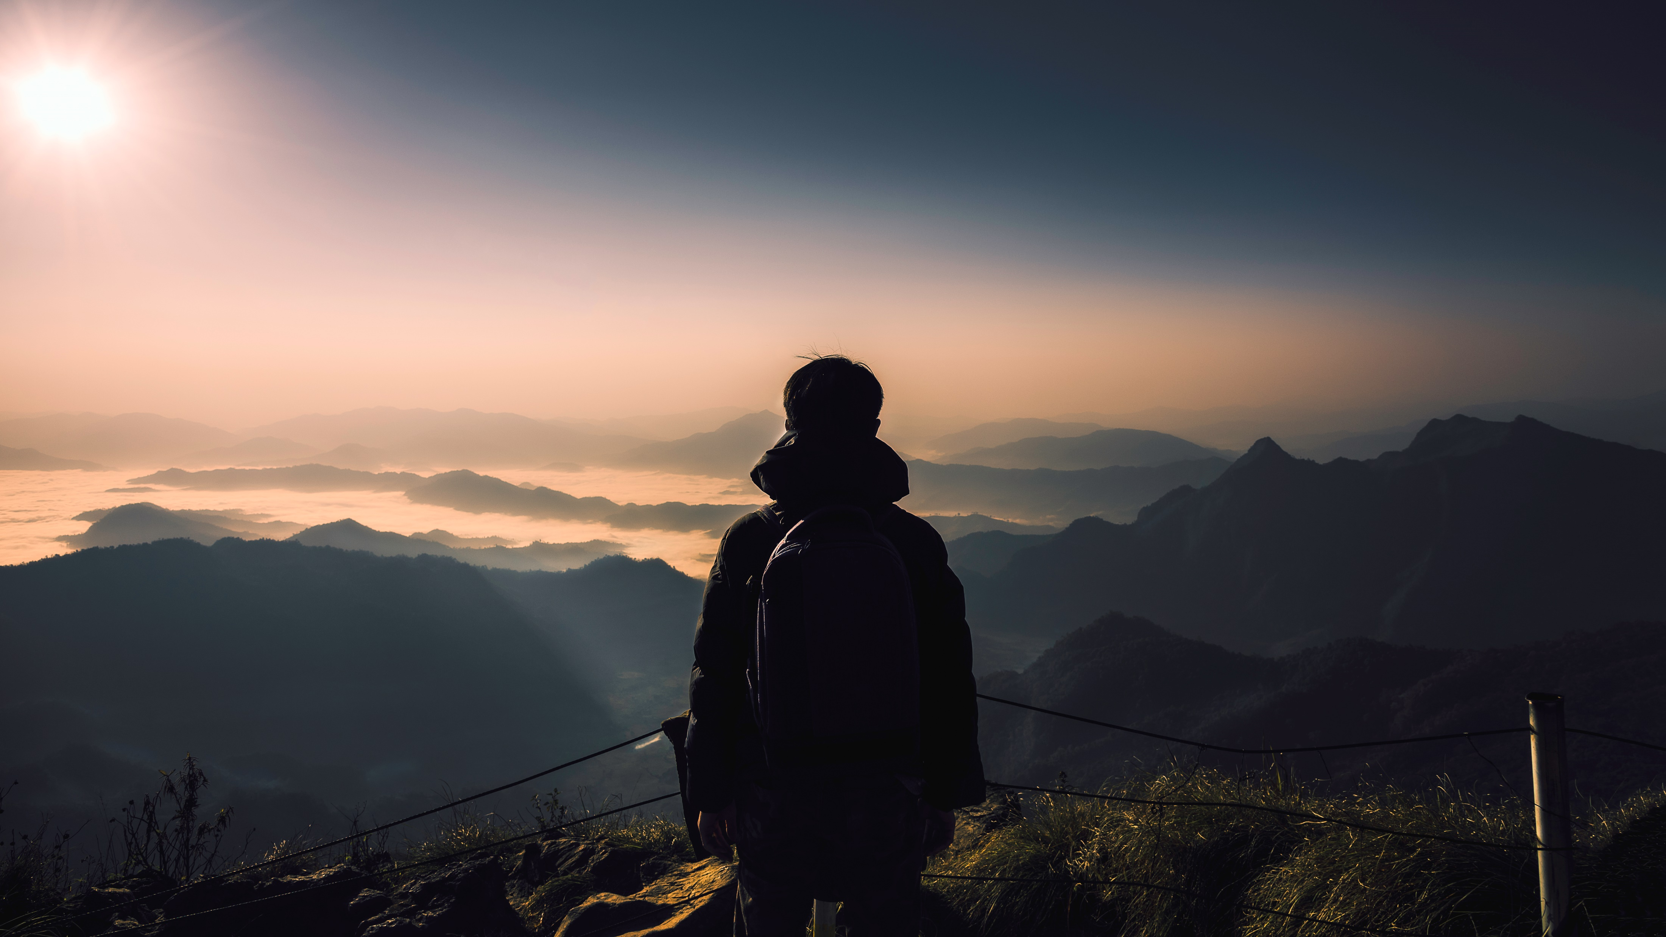
HOTEL Black & White

Slide 2


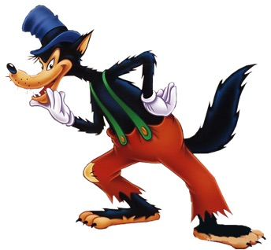
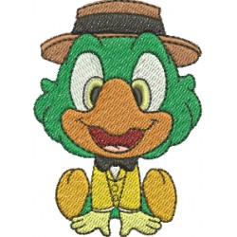
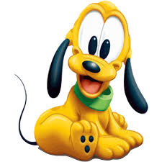

Team Retro
Wolfgang
Sandra
Barbara
Mattias

Slide 3
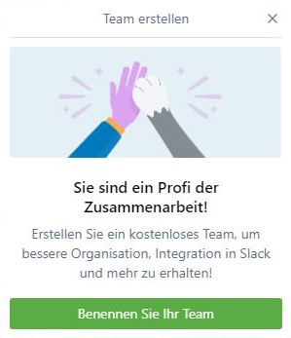
TEAM-Work
We decided everything together
Everyone was responsible for the success of our program
We found a place for everyone´s ideas
We worked together, as a Team

Slide 4
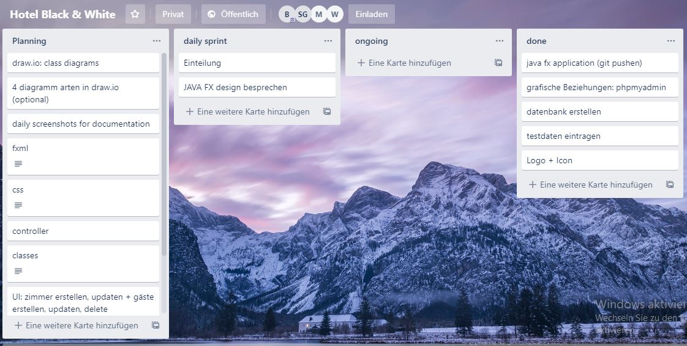
Trello – first week
planning the design
creating the program
create the database
team building

Slide 5
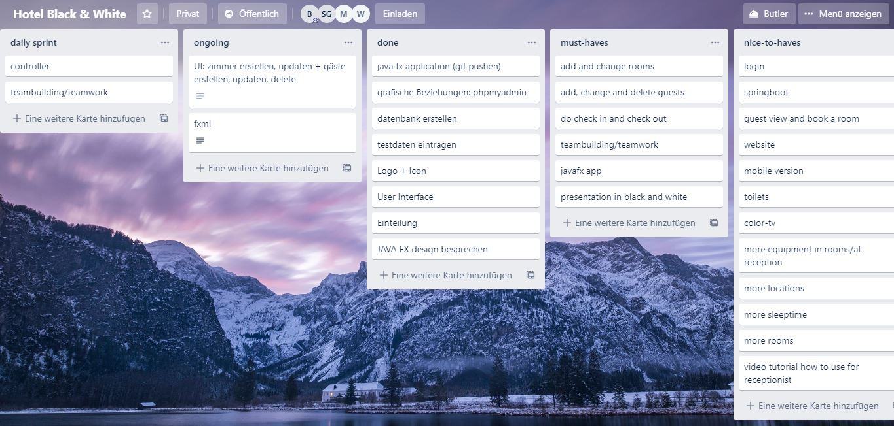
Trello – first half done
design was done
started to programming
database was created
started to create a presentation
Started to fix some issues

Slide 6
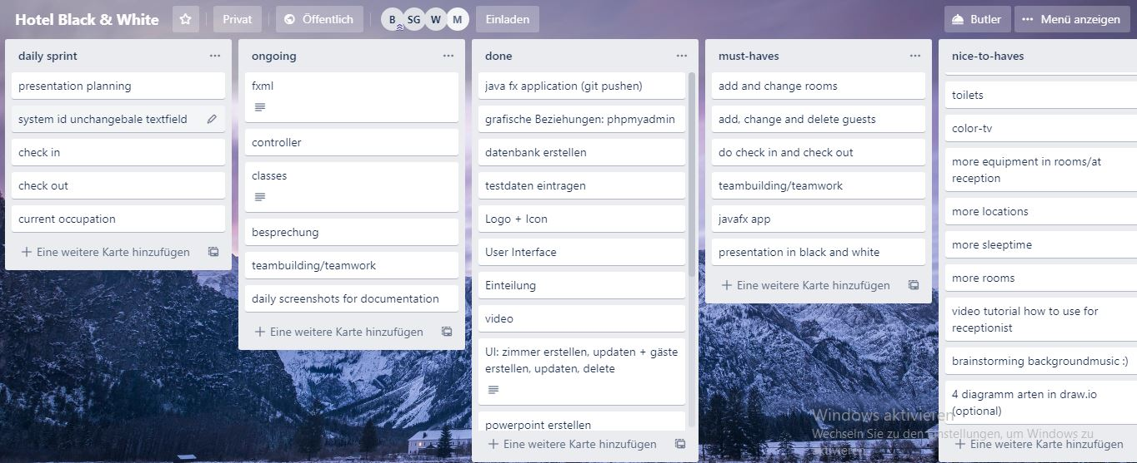
Trello – second week
finishing the program
create a presentation
testing

Slide 7
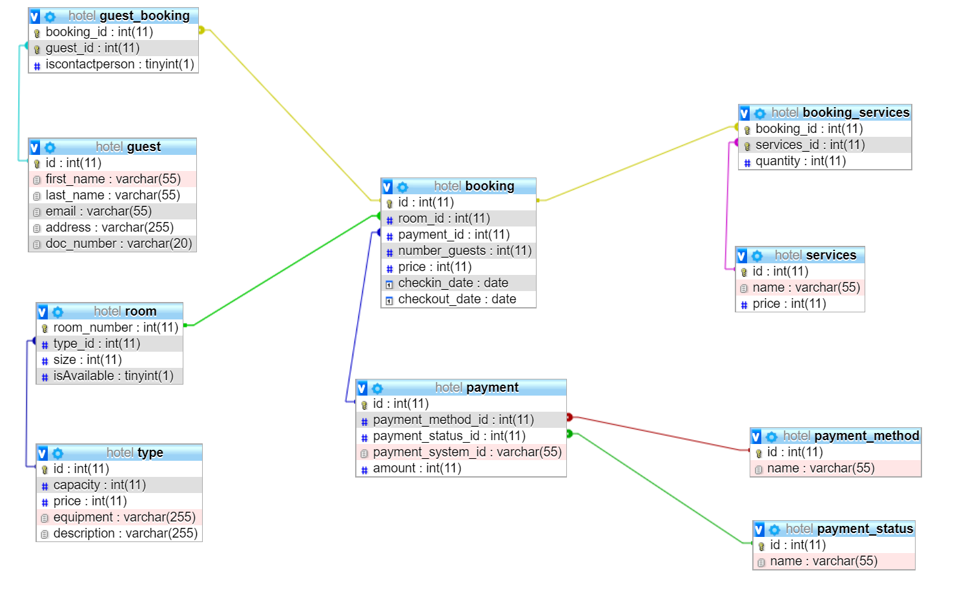

Slide 8
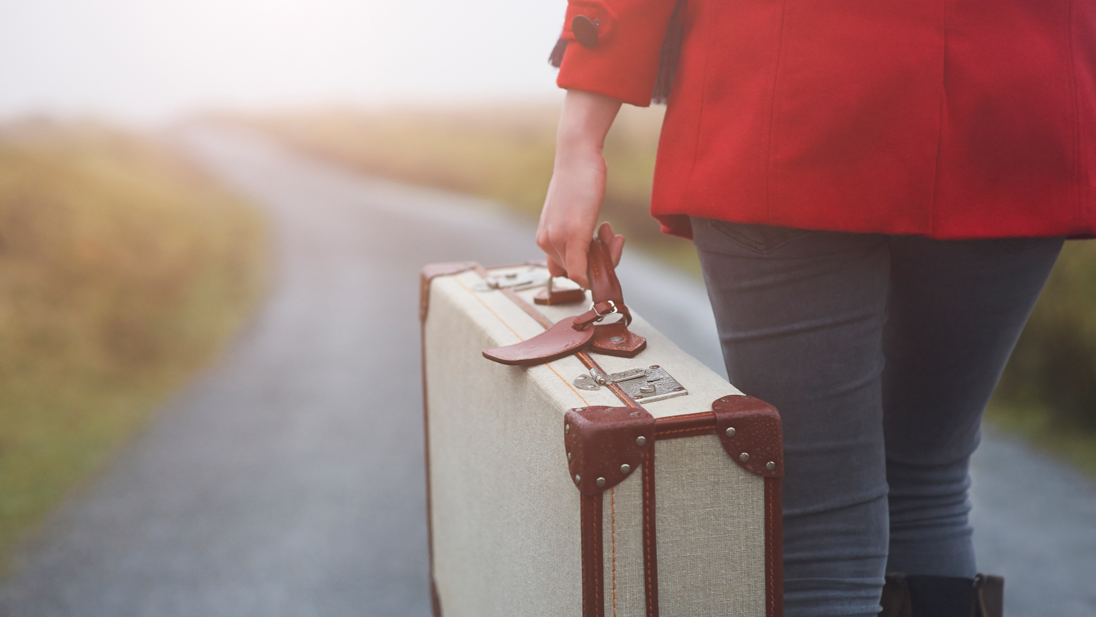
LET´S HAVE A LOOK

